Slide 1
Online Library Management System

Slide 2
Vision/Objective
This project is aimed at developing an online Library Management System (LiMS) for the college library. This is an Intranet based application that can be accessed throughout the campus. This system can be used to search for books/magazines, reserve books, find out who is having a particular book, put in requests to buy a new book etc. This is one integrated system that contains both the user component and the librarian component. There are features like email notifications or reminders, report generators etc in this system.

Slide 3
Project Specification
There are registered people in the system (students, faculty, librarian et al). Each one of them may have some exclusive privileges (faculty, for example, could borrow reference books for a short period, while students cannot).
A person should be able to login to the system through the first page of the application
change the password after logging into the system
see the status of the books/journals borrowed/reserved by him.

Slide 4
and the respective due dates and other relevant details
search for a particular book/journal based on the name of the book/name of the author/subject/etc and also list for books/journals based on the name of the author/subject etc…..
reserve a particular book/journal borrowed by others currently
cancel the reservation made earlier for a particular book/journal
get help about the LiMS on how to use the different features of the system

Slide 5
2. As soon as a reservation is made for a particular book, an automatic mail should be sent to the person who made the reservation about the details.
Then, a mail should be sent to people who are having the book currently, stating a reservation has been made on that book.
3. Automatic mails should be sent to the users about the expiry of due dates for the books/journals borrowed by them. An advance notification (say, 4 days before the expiry of the due date) should be sent as well.
4. The librarian should be able to include new books/journals or remove some books from the inventory
add new users to the system

Slide 6
• see the purchase requests for new books and be able to approve/reject the same

Slide 7
Preferred Technologies
Solutions must be created using
HTML, CSS (Web Presentation )
JavaScript (Client-side Scripting)
Java (as programming language)
JDBC, JNDI, Servlets, JSP (for creating web applications)
Eclipse with MyEclipse Plug-in (IDE/Workbench)
Oracle/Access (Database)
Windows XP/2003 or Linux/Solaris (Operating System)

Slide 8
Other Details
The application should be highly secured and with different levels & categories of access control.

Slide 9
Software Requirements:
Operating System : Windows XP/2003 or Linux/Solaris
User Interface : HTML, CSS
Client-side Scripting : JavaScript
Programming Language : Java
Web Applications : JDBC, Servlets, JSP
IDE/Workbench : My Eclipse 8.x
Database : Oracle 10g
Server Deployment : Tomcat 6.x

Slide 10
Hardware Requirements:
Processor : Pentium IV
Hard Disk : 40GB
RAM : 1GB or more

Slide 11
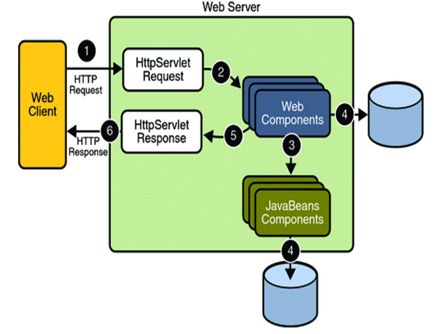
SYSTEM REQUIREMENT SPECIFICATION :

Slide 12
PROCESS FLOW:
THE PRESENTATION LAYER:
Also called as the client layer comprises of components that are dedicated to presenting the data to the user. For example: Windows/Web Forms and buttons, edit boxes, Text boxes, labels, grids.
THE BUSINESS RULES LAYER:
This layer encapsulates the Business rules or the business logic of the encapsulations. To have a separate layer for business logic is of a great advantage. This is because any changes in Business Rules can be easily handled in this layer. As long as the interface between the layers remains the same, any changes to the functionality/processing logic in this layer can be made without impacting the others. A lot of client-server apps failed to implement successfully as changing the business logic was a painful process

Slide 13
Process Flow:
THE DATA ACCESS LAYER:
This layer comprises of components that help in accessing the Database. If used in the right way, this layer provides a level of abstraction for the database structures. Simply put changes made to the database, tables, etc do not affect the rest of the application because of the Data Access layer. The different application layers send the data requests to this layer and receive the response from this layer.
THE DATABASE LAYER:
This layer comprises of the Database Components such as DB Files, Tables, Views, etc. The Actual database could be created using SQL Server, Oracle, Flat files, etc. In an n-tier application, the entire application can be implemented in such a way that it is independent of the actual Database. For instance, you could change the Database Location with minimal changes to Data Access Layer. The rest of the Application should remain unaffected

Slide 14
Functional Requirements:
Technologies:
J2EE: Application Architecture.
Oracle 10g: Database.
My Eclipse 8.6: Development Tool.
Tomcat: Web Server.
Star UML: Design Tool.
Overview
SRS will include two sections.
Overall Description will describe major components of the system, interconnection and external interfaces.
Specific Requirements will describe the functions of actors, their role in the system and constraints.
Product Perspective
The web pages (XHTML/JSP) are present to provide the user interface on customer client side. Communication between customer and server is provided through HTTP/HTTPs Protocols.
The Client Software is to provide the user interface on system user client side and for this TCP/IP protocols are used.

Slide 15
System Interfaces:
Client on Intranet:
Client Software, Web Browser, Operating System (any)
Web Server:
Tomcat, Operating System (any)
Data Base Server:
Oracle, Operating System (any)
Development End:
My Eclipse (J2EE, Java, servlets, JSP), Oracle, OS (Windows), Web server.
Communication Interface
Client on Internet will be using HTTP/HTTPS Protocol.
Client on intranet will be using TCP/IP protocol.

Slide 16
Non Functional Requirements:
Performance Requirements:
Some of the attributes of software that relate to the ease of porting the software to other host machines and/or operating systems.
This may include:
Java is used to develop the product. So it is easiest to port the software in any environment.

Slide 17
Maintainability:
The user will be able to reset all options and all stored user variables to default settings.
Reliability:
Some of the attributes identified for the reliability is listed below:
All data storage for user variables will be committed to the database at the time of entry.
Data corruption is prevented by applying the possible backup procedures and techniques.
Usability requirements:
Some of the usability requirements identified for this system are listed below:
A logical interface is essential to an easy to use system, speeding up common tasks.
Error prevention is integral to the system and is provided in a number of formats from sanity hacks to limiting free-text input.

Slide 18
Availability:
All cached data will be rebuilt during every startup. There is no recovery of user data if it is lost. Default values of system data will be assigned when necessary
Software System Attributes:
There are a number of attributes of software that can serve as requirements. It is important that required attributes by specified so that their achievement can be objectively verified. The following items provide a partial list of examples.
The input system will allow for inputting numbers, operands, special symbols and letters of the alphabet.

Slide 19
FEASIBILITY STUDY:
TECHNICAL FEASIBILITY:
Evaluating the technical feasibility is the trickiest part of a feasibility study. This is because, at this point in time, not too many detailed design of the system, making it difficult to access issues like performance, costs on (on account of the kind of technology to be deployed) etc. A number of issues have to be considered while doing a technical analysis.
Understand the different technologies involved in the proposed system:
Before commencing the project, we have to be very clear about what are the technologies that are to be required for the development of the new system.
Find out whether the organization currently possesses the required technologies:
Is the required technology available with the organization?
If so is the capacity sufficient?
For instance –
“Will the current printer be able to handle the new reports and forms required for the new system?”

Slide 20
OPERATIONAL FEASIBLITY:
Proposed projects are beneficial only if they can be turned into information systems that will meet the organizations operating requirements. Simply stated, this test of feasibility asks if the system will work when it is developed and installed. Are there major barriers to Implementation? Here are questions that will help test the operational feasibility of a project:
Is there sufficient support for the project from management from users? If the current system is well liked and used to the extent that persons will not be able to see reasons for change, there may be resistance.
Are the current business methods acceptable to the user? If they are not, Users may welcome a change that will bring about a more operational and useful systems.
Have the user been involved in the planning and development of the project?
Early involvement reduces the chances of resistance to the system and in
General and increases the likelihood of successful project.
Since the proposed system was to help reduce the hardships encountered. In the existing manual system, the new system was considered to be operational feasible.

Slide 21
ECONOMIC FEASIBILITY:
Economic feasibility attempts 2 weigh the costs of developing and implementing a new system, against the benefits that would accrue from having the new system in place. This feasibility study gives the top management the economic justification for the new system.
A simple economic analysis which gives the actual comparison of costs and benefits are much more meaningful in this case. In addition, this proves to be a useful point of reference to compare actual costs as the project progresses. There could be various types of intangible benefits on account of automation. These could include increased customer satisfaction, improvement in product quality better decision making timeliness of information, expediting activities, improved accuracy of operations, better documentation and record keeping, faster retrieval of information, better employee morale.

Slide 22
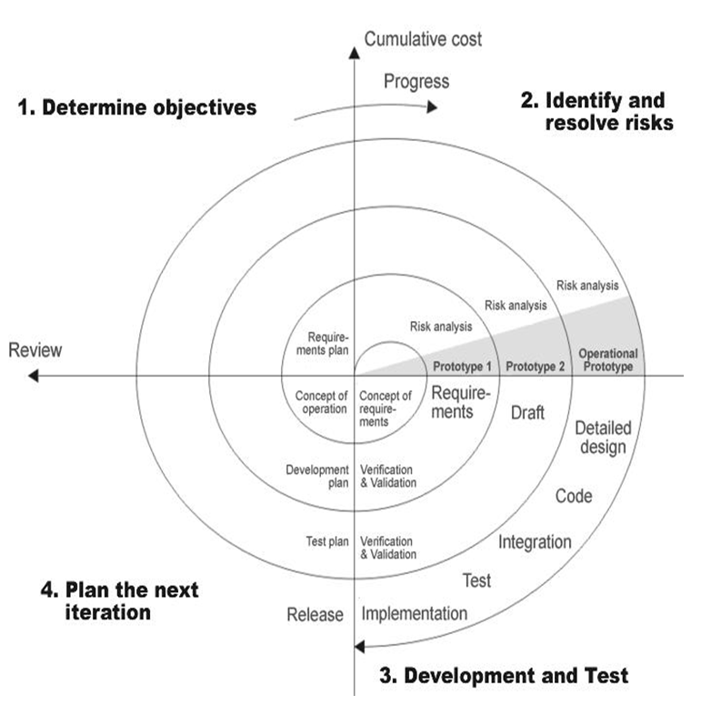
SPIRAL MODEL:

Slide 23
Applications:
Spiral Model is very widely used in the software industry as it is in synch with the natural development process of any product i.e. learning with maturity and also involves minimum risk for the customer as well as the development firms. Following are the typical uses of Spiral model:
When costs there is a budget constraint and risk evaluation is important.
For medium to high-risk projects.
Long-term project commitment because of potential changes to economic priorities as the requirements change with time.
Customer is not sure of their requirements which is usually the case.
Requirements are complex and need evaluation to get clarity.
New product line which should be released in phases to get enough customer feedback.
Significant changes are expected in the product during the development cycle.

Slide 24
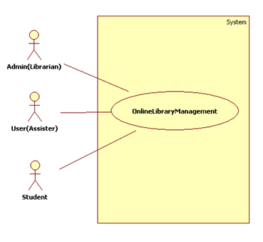
UML DIAGRAMS:

Slide 25
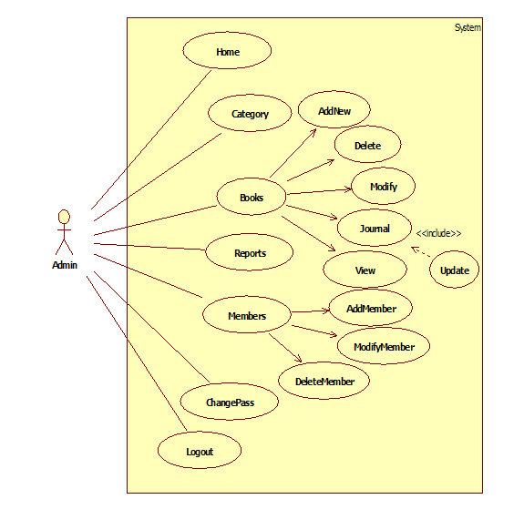
Admin Use Case Diagram:

Slide 26
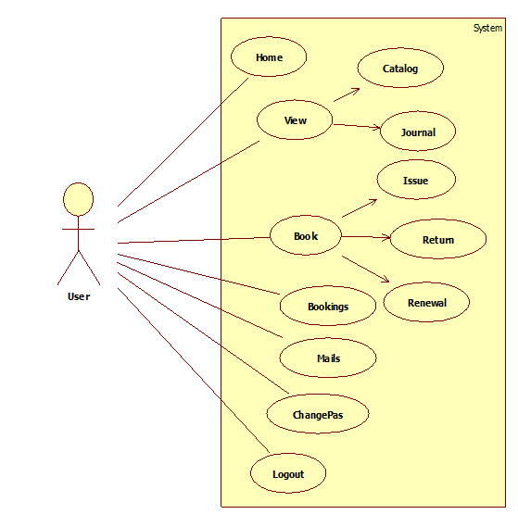
User Use Case Diagram:

Slide 27
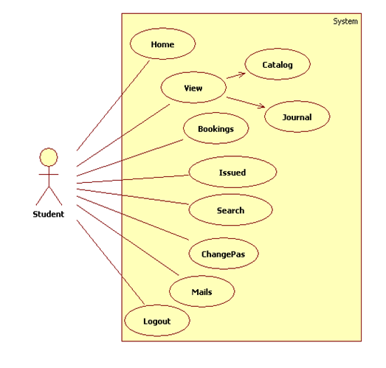
Student Use Case Diagram:

Slide 28
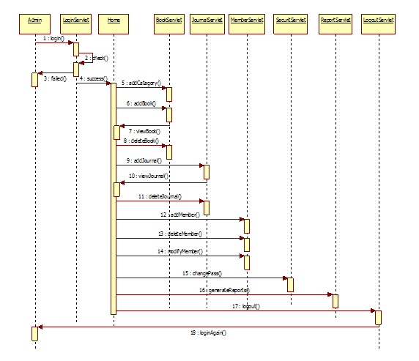
Admin Sequence Diagram:

Slide 29
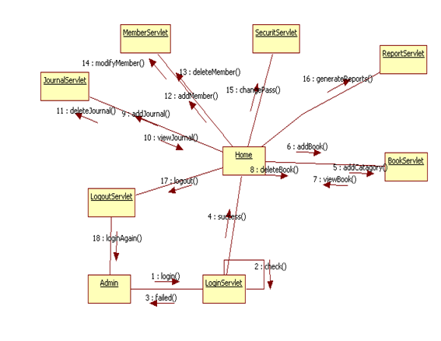
Admin Colloboration Diagram:

Slide 30
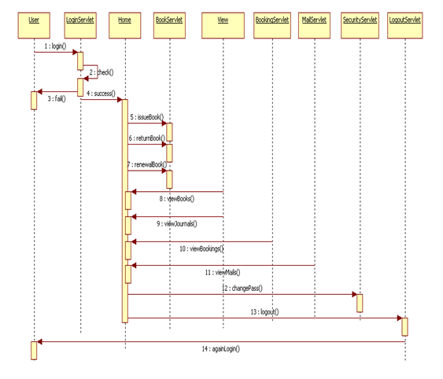
User Sequence Diagram:

Slide 31
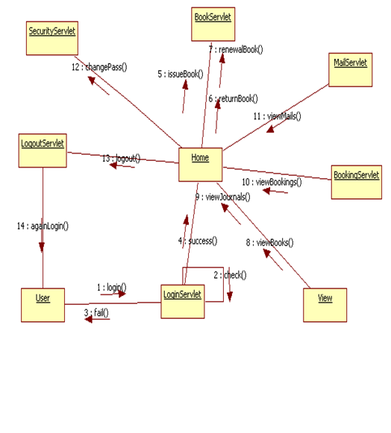
Collaboration Diagram:

Slide 32
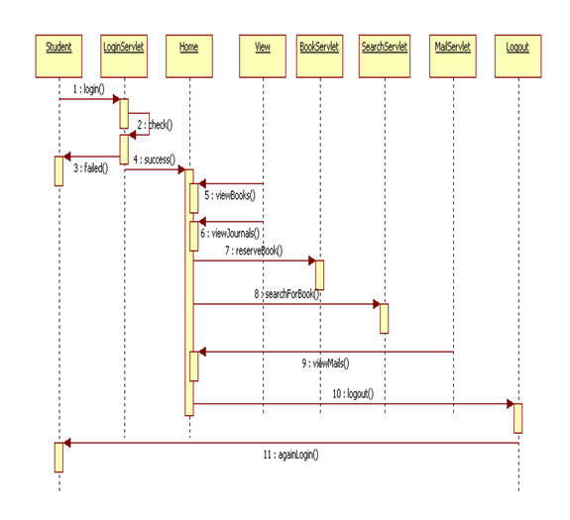
Student Sequence Diagram:

Slide 33
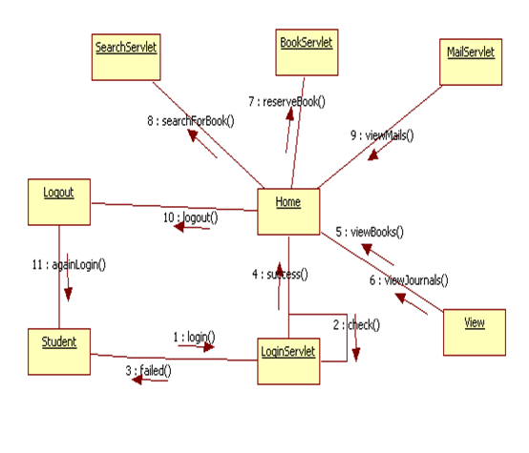
Student Collaboration Diagram:

Slide 34
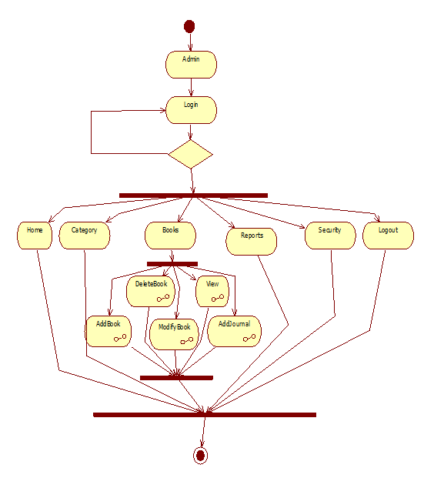
Admin Activity Diagram:

Slide 35
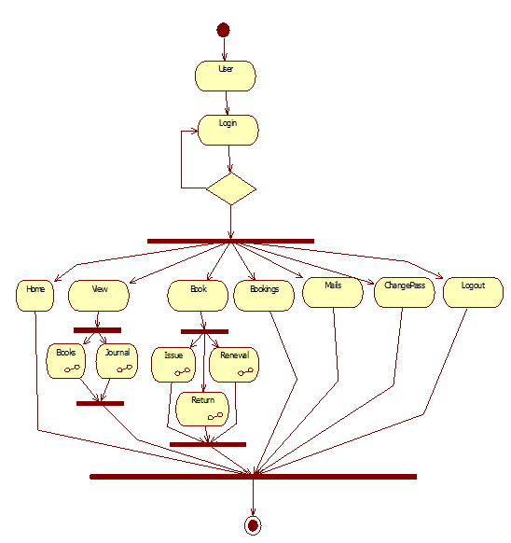
User Activity Diagram:

Slide 36
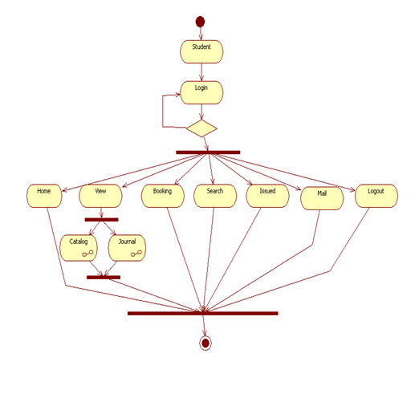
Student Activity Diagram:

Slide 37
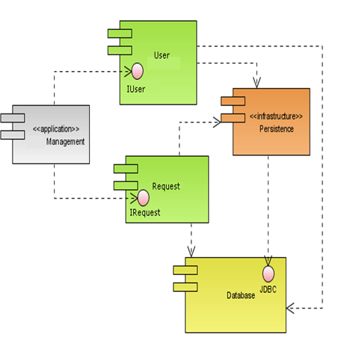
Component Diagram:

Slide 38
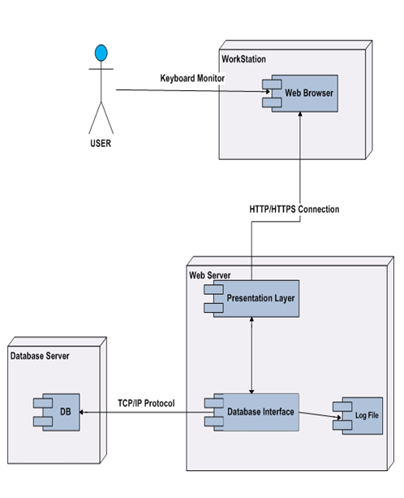
Deployment Diagram:

